Slide 1


EBC mooring
Eastern Boundary Current
North Atlantic Subtropical Gyre
Pedro Vélez-Belchí, Eugenio Fraile-Nuez & Federico López-Laatzen
Instituto Español de Oceanografía
Alonso Hernández-Guerra
Universidad de Las Palmas de Gran Canaria

Slide 2
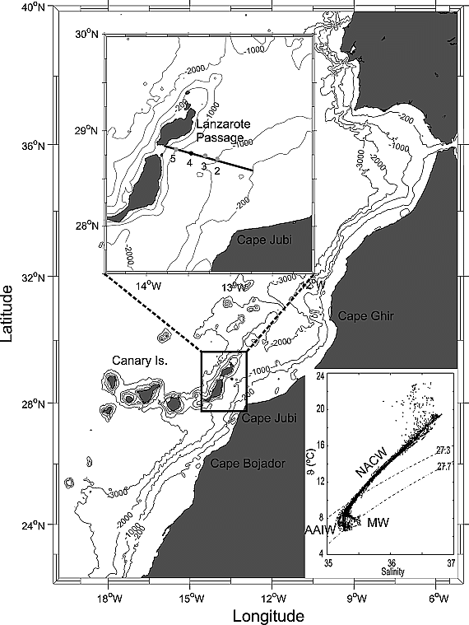
EBC - Location
Lanzarote Passage: Between the Canary Islands and the African coast
Starting: January 1997

Slide 3
EBC
1997-1999: 4 moorings with a total of 19 current meters
1999-nowdays: EBC-4
NACW
AAIW
MW

Slide 5
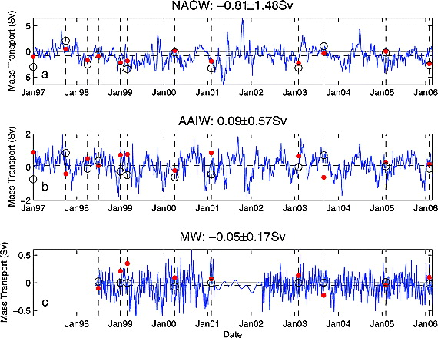

Slide 6
